Slide 1
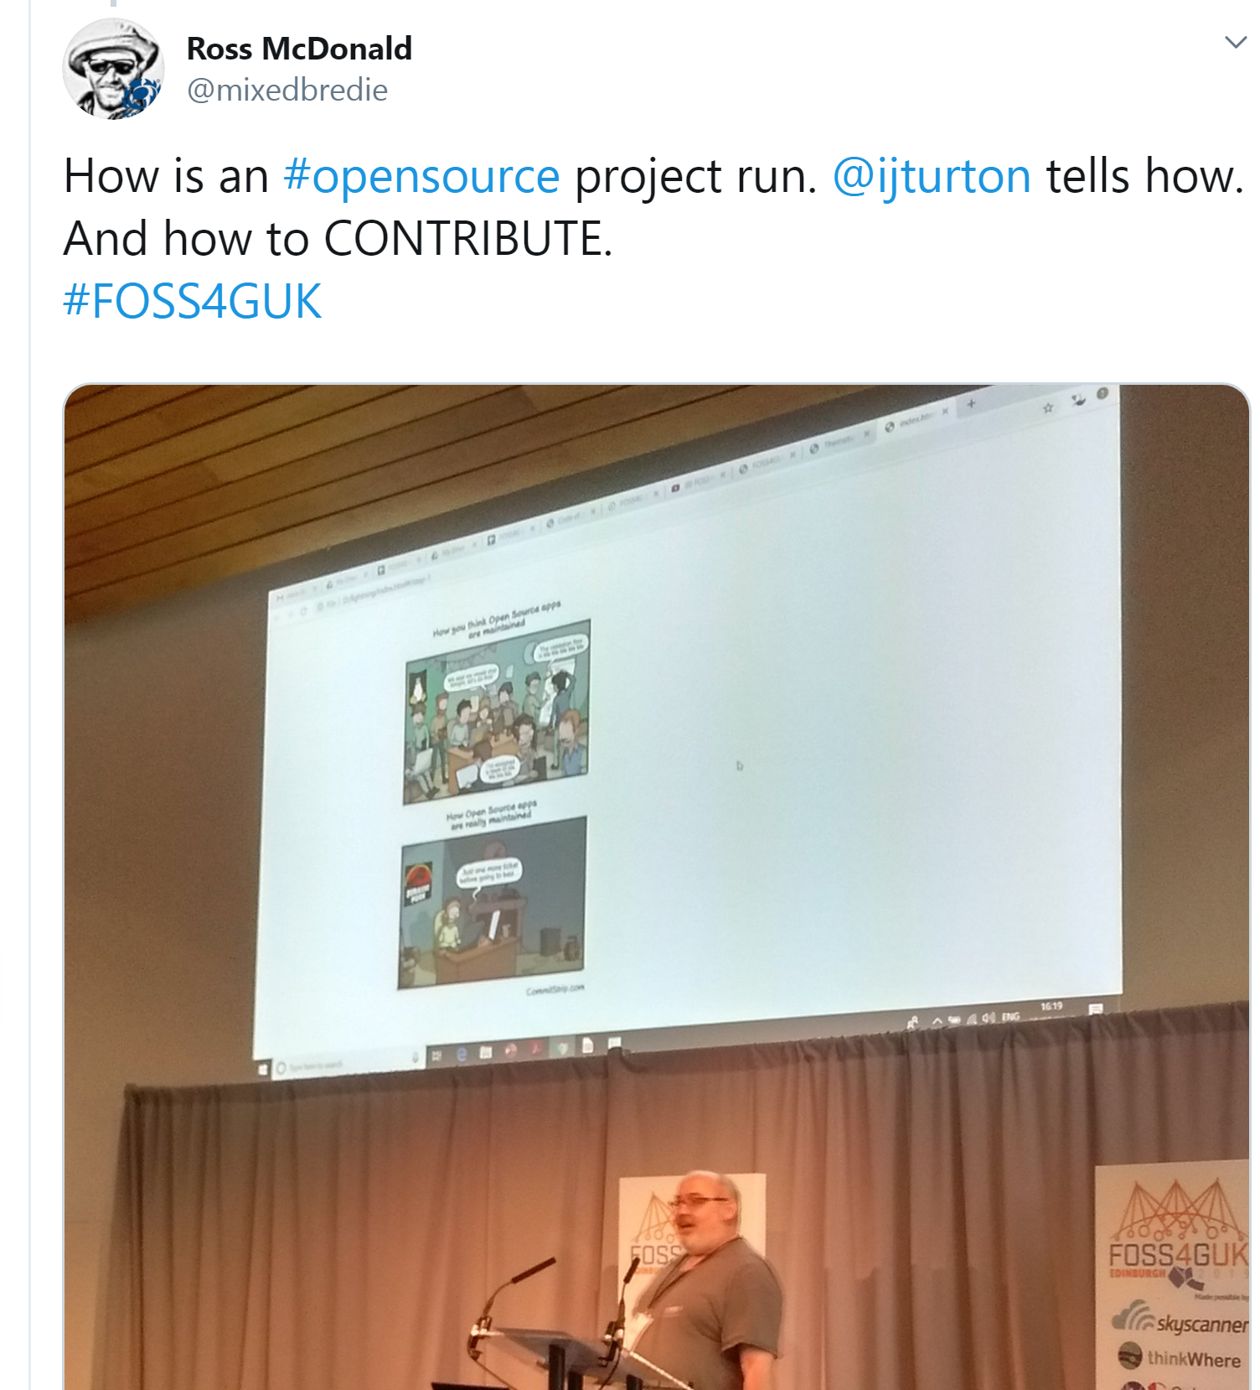

Contributing to QGIS Documentation
Nick Bearman
This work is licensed under a Creative Commons Attribution-ShareAlike 4.0 International License.
https://twitter.com/mixedbredie/status/1174705292619239424

Slide 2
Mentimeter questions

Slide 3
Why Open Source?
OpenSource is free
Gratis (£0)
Libre
Can do whatever we want with it
Free to look at the code that runs underneath and alter it
For OpenSource to grow, it needs contributors
time
££

Slide 4
Open Source needs contributions
QGIS doing fairly well for coders
QGIS needs writers more than coders
QGIS Documentation is massive
Just pick one bit and focus on that
Many updates for new versions need to be added

Slide 5
Why QGIS?
QGIS is the biggest open source GIS
I know QGIS well
It has a central documentation framework (unlike, e.g. R).

Slide 6
Am I a ‘writer’?
what do I need to be able to do to be a writer?
write instructions / explanation. You probably know already whether you are happy writing, or not.
different types of writing
'academic writing' is not my cup of tea - can't do it.
but I can do workbooks and instructions :-)

Slide 7
Season of the Docs
Funded by Google
Two writers allocated for OSGeo projects
One for GeoNetwork
One for The Good Docs Project
Guidance for Good Documentation

Slide 8
What do I write about?
what interests you...
what's easy!
don't make life hard for yourself.

Slide 9
How do I write for QGIS?
That’s why we’re here ☺
Aside:
If writing lots (> two sentences) then try and split up the process into
Content
Style
(as per LaTeX, Markdown, etc.)
It makes the process easier.

Slide 10
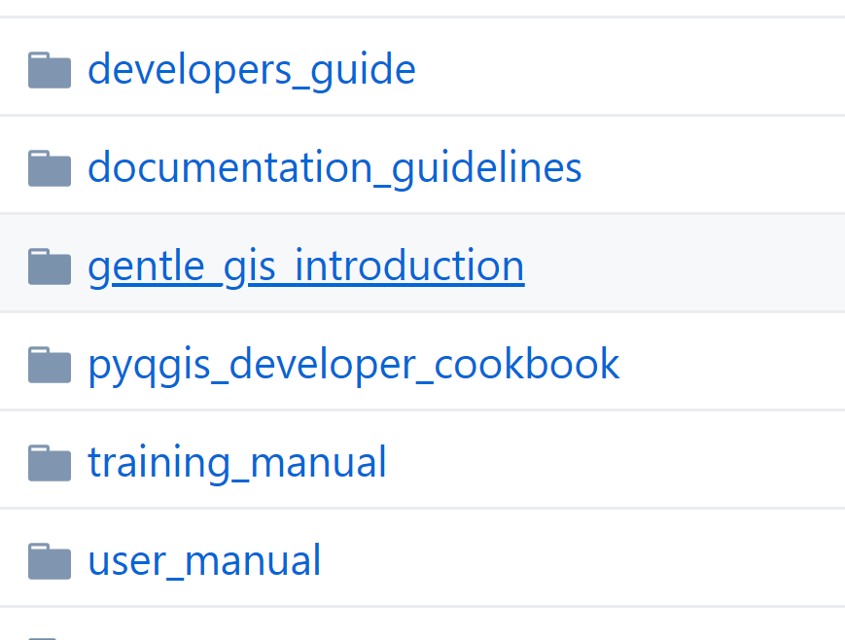
How are documents structured?
QGIS User Guide / Manual
QGIS Training Manual
PyQGIS Cookbook

Slide 11
QGIS Documentation
Hosted on GitHub using Git version control
Written in RST (a bit like Markdown)
Plain text and ‘markup’ language
E.g. :

Slide 12
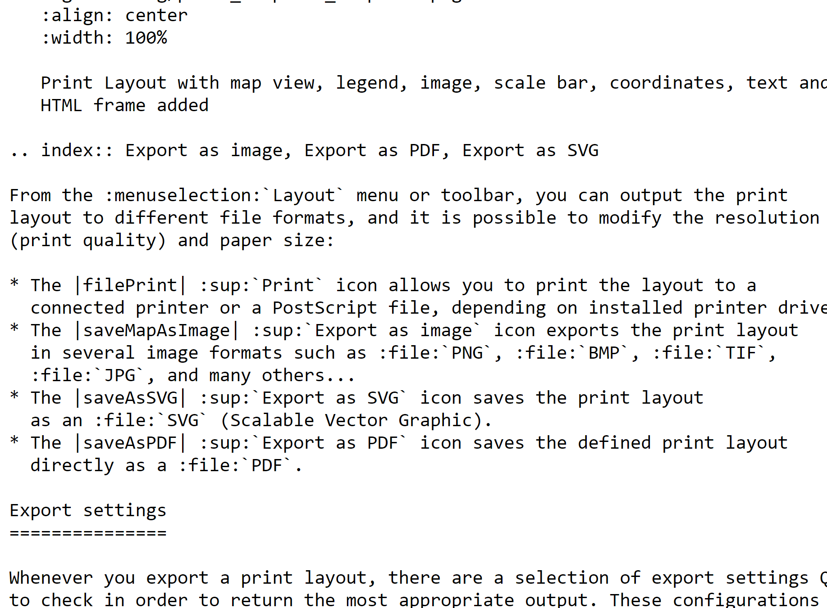
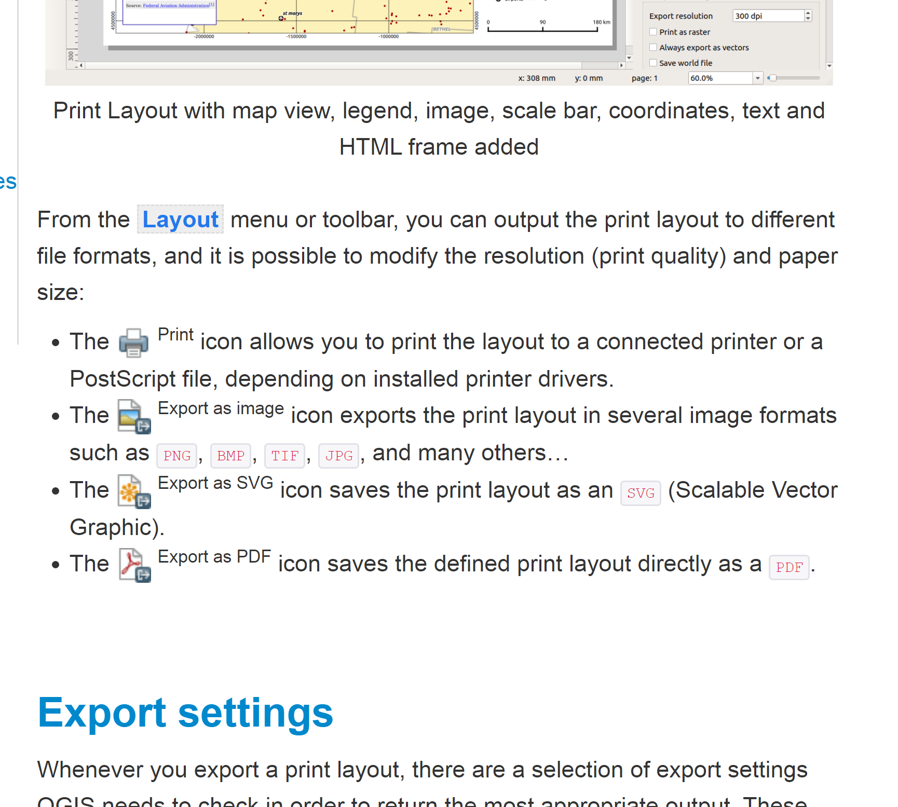
QGIS Documentation
Hosted on GitHub using Git version control
Written in RST (ReStructuredText, like Markdown)
Plain text and ‘markup’ language
E.g. :
https://docs.qgis.org/3.4/en/docs/user_manual/print_composer/create_output.html
https://raw.githubusercontent.com/qgis/QGIS-Documentation/master/source/docs/user_manual/print_composer/create_output.rst

Slide 13
Three ways of editing
Using ‘Fix Me’ link (web browser)
Using Git locally on computer (+git)
Compiling locally (+Sphinx)

Slide 14
Three ways of editing
Using ‘Fix Me’ link (web browser)
Using Git locally on computer (+git)
Compiling locally (+Sphinx)

Slide 15
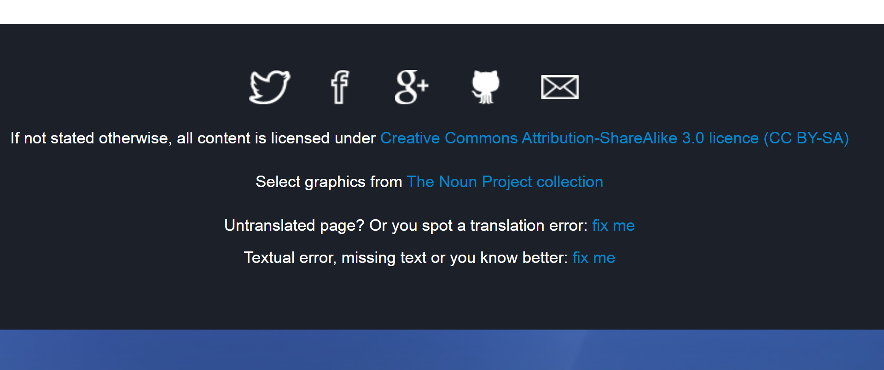
1. Using ‘Fix Me’ link (web browser)

Slide 16
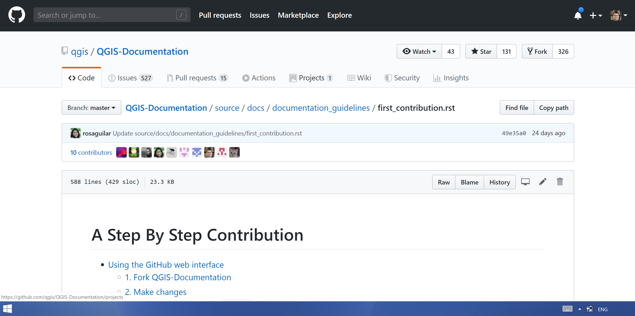

Slide 17
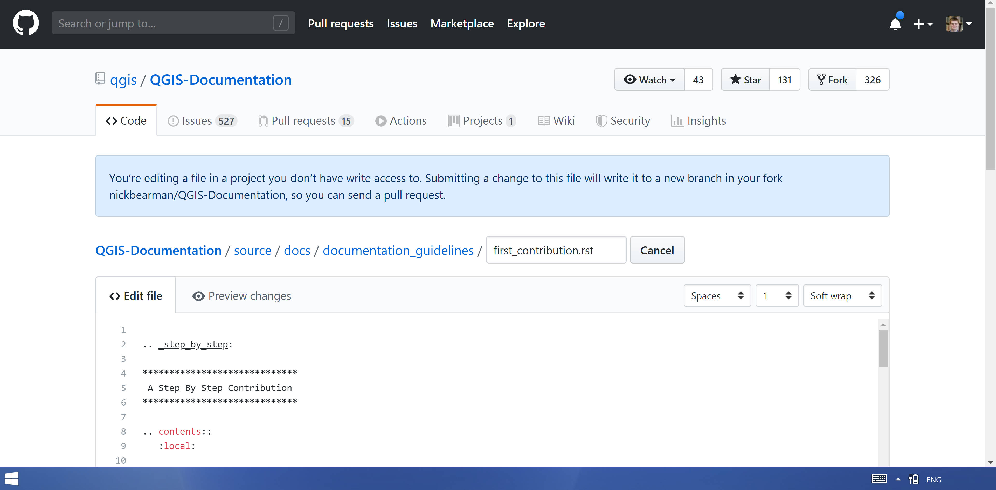

Slide 18
Go to: bit.ly/qgis-doc https://github.com/nickbearman/Contributing-to-QGIS-Documentation

Slide 19
Walk through Edit on GitHub
make change
- preview (not perfect preview, only rough)
- say what you did
- make a new branch and PR
- submit
- can also browse through github and use edit pencil icon.

Slide 20
Pros and Cons of 1 Fix Me / Edit on GitHub
Pros
fast editing
no setup needed
can do from anywhere (any browser)
Cons
can only edit one file
can't add images
can't adjust your pull request once it is submitted (in the easy way)

Slide 21
Using Git locally on computer (+git)
Walk through, time to experiment
Install Git
Pull repo
Make change
Commit
Push
(paper instructions)
Images?

Slide 22
Using Git locally on computer (+git)
Pros
can add multiple files
can add images
can adjust your PR
Cons
no full preview
some learning curve

Slide 23
Using ‘Fix Me’ link (web browser)
Using Git locally on computer (+git)
Compiling locally (+ Sphinx)
Not looking at 3 now.
Time consuming to setup

Slide 24
Next steps….
Actually change some QGIS Documentation!
Issues are listed on GitHub
https://github.com/qgis/QGIS-Documentation/
Some are tagged ‘Easy’
https://github.com/qgis/QGIS-Documentation/labels/Easy
Some are screenshots
All have version number (3.8, 3.10)
3.10 is QGIS Master (next version)
OSGeo Installer for Windows
Have a go!
Tag me in the PR
Ask if you have questions..

Slide 25
Hackathon
Tomorrow
(details)
Will be leading a session on documentation
See you then!

